Slide 1
Derivatives
Enrique Covarrubias
ecovarrubias@actinver.com.mx
Tel. 01 (55) 1103-6600
Ext. 1061
Gustavo Muñoz
gumunoz@actinver.com.mx
Tel. 01 (55) 1103-6600
Ext. 2466

Slide 2
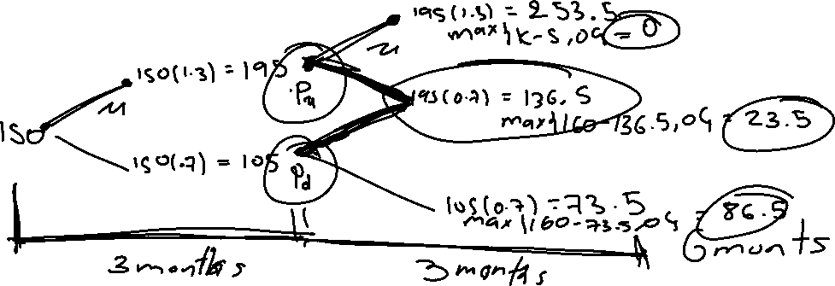
Derivatives
Binomial Trees – General
In multiple step cases, An option is priced by starting at the end of the tree and recursicvely moving backwards
Example: For a 6-month European put option on a stock, you are given:
The stock price is 150.
The strike price is 160.
𝑢 = 1.3 and 𝑑=0.7
The continuously compounded risk-free rate is 6%.
There are no dividends.

Slide 3
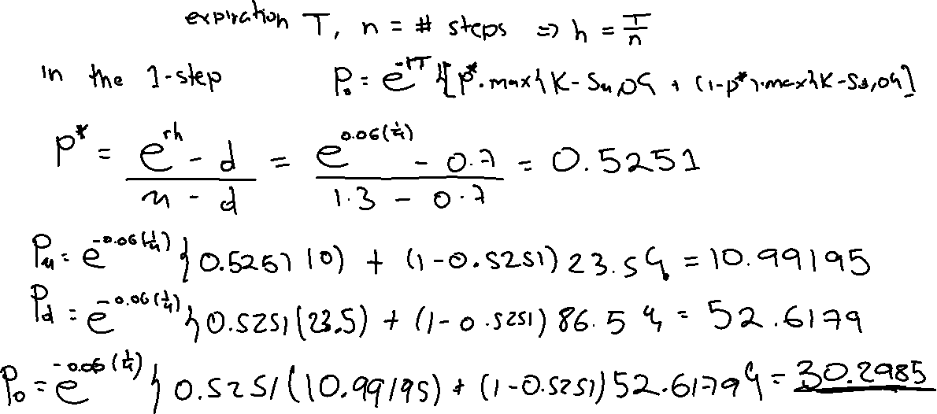
Derivatives
Binomial Trees – General
Example (developed in class):

Slide 4
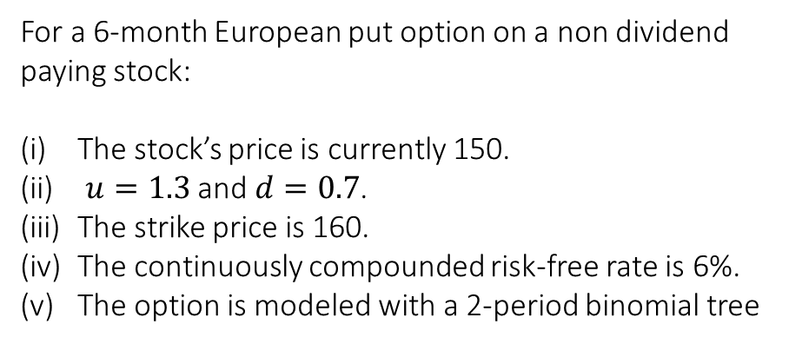
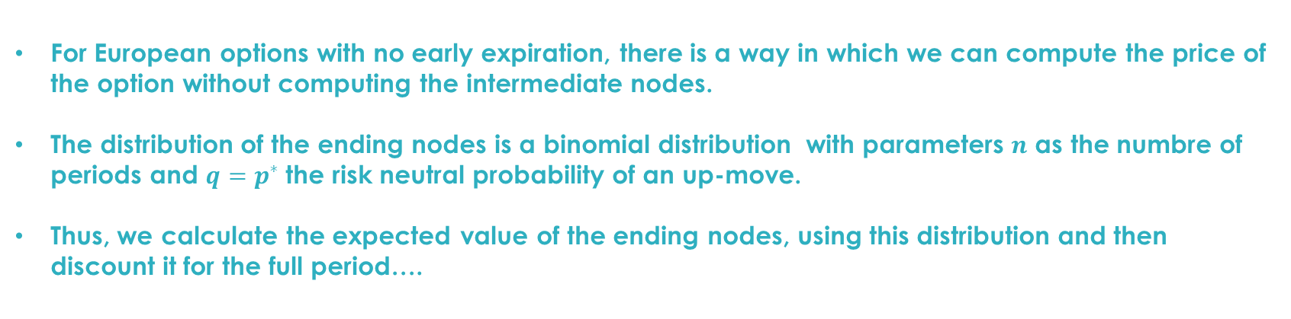


Derivatives
Binomial Trees – General
For European options with no early expiration, there is a way in which we can compute the price of the option without computing the intermediate nodes.
The distribution of the ending nodes is a binomial distribution with parameters $n$ as the numbre of periods and $q=p^{∗}$the risk neutral probability of an up-move.
Thus, we calculate the expected value of the ending nodes, using this distribution and then discount it for the full period….
For a 6-month European put option on a non dividend paying stock:
The stock’s price is currently 150.
$u=1.3$ and $d=0.7$.
The strike price is 160.
The continuously compounded risk-free rate is 6%.
The option is modeled with a 2-period binomial tree
$$X\sim Bin(n,p)$$
$$f_{X}\left(x\right)=P\left[X=x\right]=\left(\begin{matrix}n \\ x\end{matrix}\right)p^{x}{\left(1−p\right)}^{n−x}$$
$$f_{X}\left(x\right)=P\left[X=x\right]=\frac{n!}{(n−x)!x!}p^{x}{\left(1−p\right)}^{n−x}$$

Slide 5
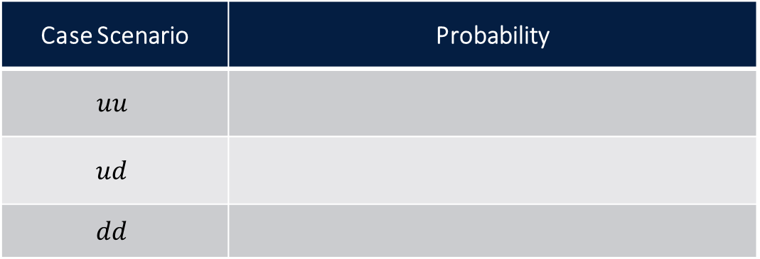
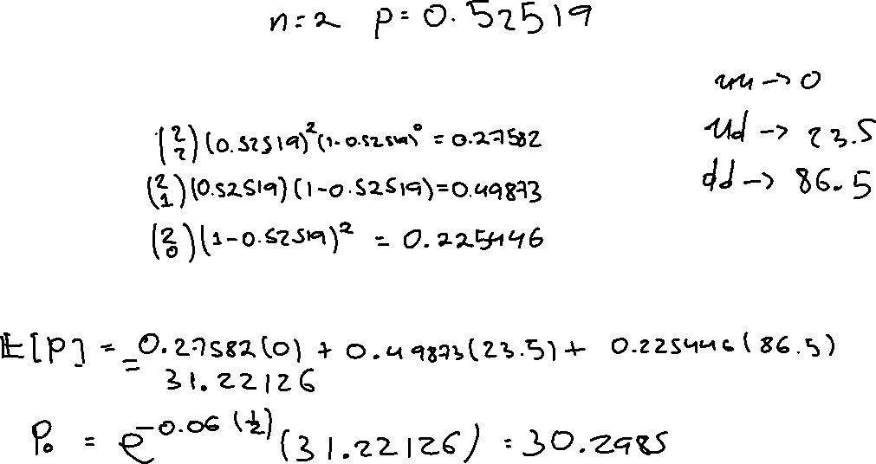
Derivatives
Binomial Trees – General
Example (developed in class):
Case Scenario | Probability
$$uu$$
$$ud$$
$$dd$$
The expected value of the ending put value is:
So, the put premium is…

Slide 6
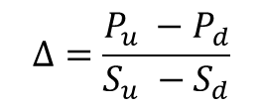


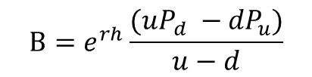
Derivatives
Binomial Trees – General
It is also possible to compute $Δ$ and B at each node. These calculations are done using the option values at the nodes. For example, at the initial node,
$$Δ=\frac{P_{u} −P_{d}}{S_{u} −S_{d}}$$
$$B=e^{rh}\frac{(uP_{d} −{dP}_{u})}{u−d}$$
$$P_{0}=ΔS_{0}+B$$

Slide 7
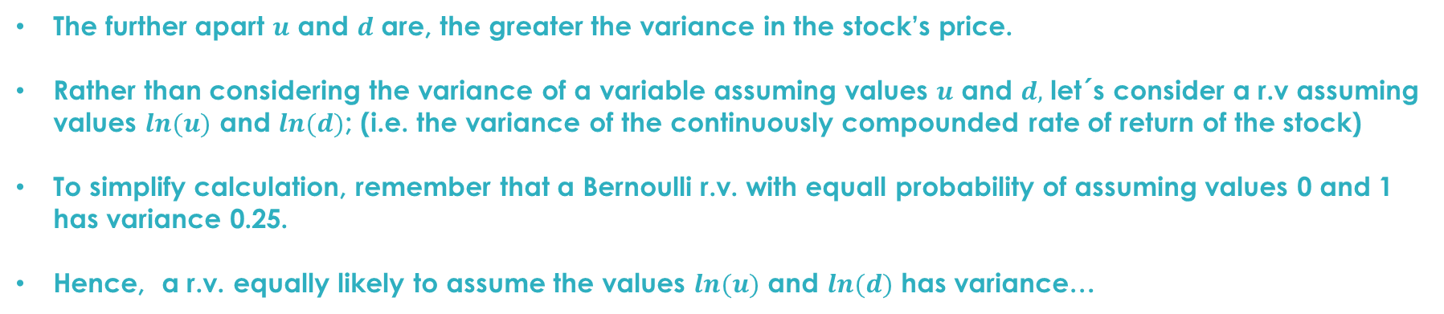
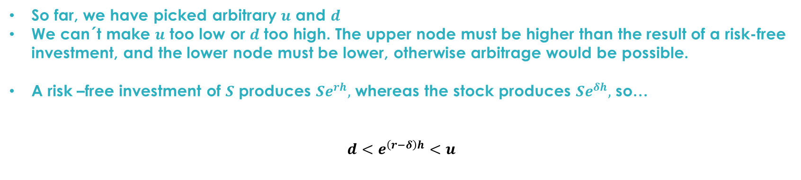
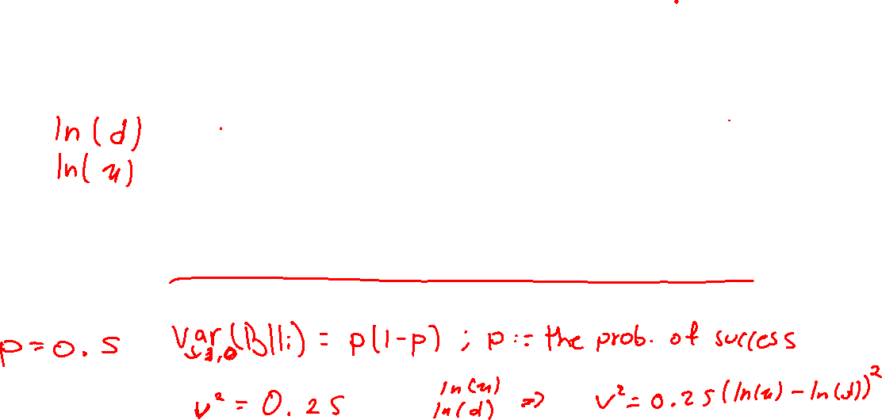
Derivatives
Volatility
So far, we have picked arbitrary $u$ and $d$
We can´t make $u$ too low or $d$ too high. The upper node must be higher than the result of a risk-free investment, and the lower node must be lower, otherwise arbitrage would be possible.
A risk –free investment of $S$ produces $Se^{rh},$ whereas the stock produces $Se^{δh},$ so…
$$d<e^{\left(r−δ\right)h}<u$$
The further apart $u$ and $d$ are, the greater the variance in the stock’s price.
Rather than considering the variance of a variable assuming values $u$ and $d,$ let´s consider a r.v assuming values $ln(u)$ and $ln(d)$; (i.e. the variance of the continuously compounded rate of return of the stock)
To simplify calculation, remember that a Bernoulli r.v. with equall probability of assuming values 0 and 1 has variance 0.25.
Hence, a r.v. equally likely to assume the values $ln(u)$ and $ln(d)$ has variance…

Slide 8

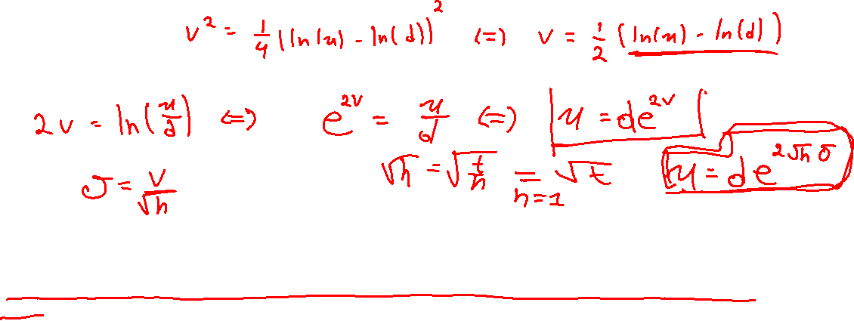
Derivatives
Volatility
While our trees does not always have a 50/50 probability of an up or down move, we will calculate the variance as if the probability is 0.5.
Then, solving for $d$ in terms of $u$:
$v$ is the square root of the variance, or the volatility of one period, we annualize it by dividing it by $√h$ where $h$ is the size of the period. Thus $σ=v/√h$ is the annual volatility.
To determine $u$ and $d$ we first specify the volatility of the stock, then, given a $d$ and set for $u$ or voce-versa

Slide 9
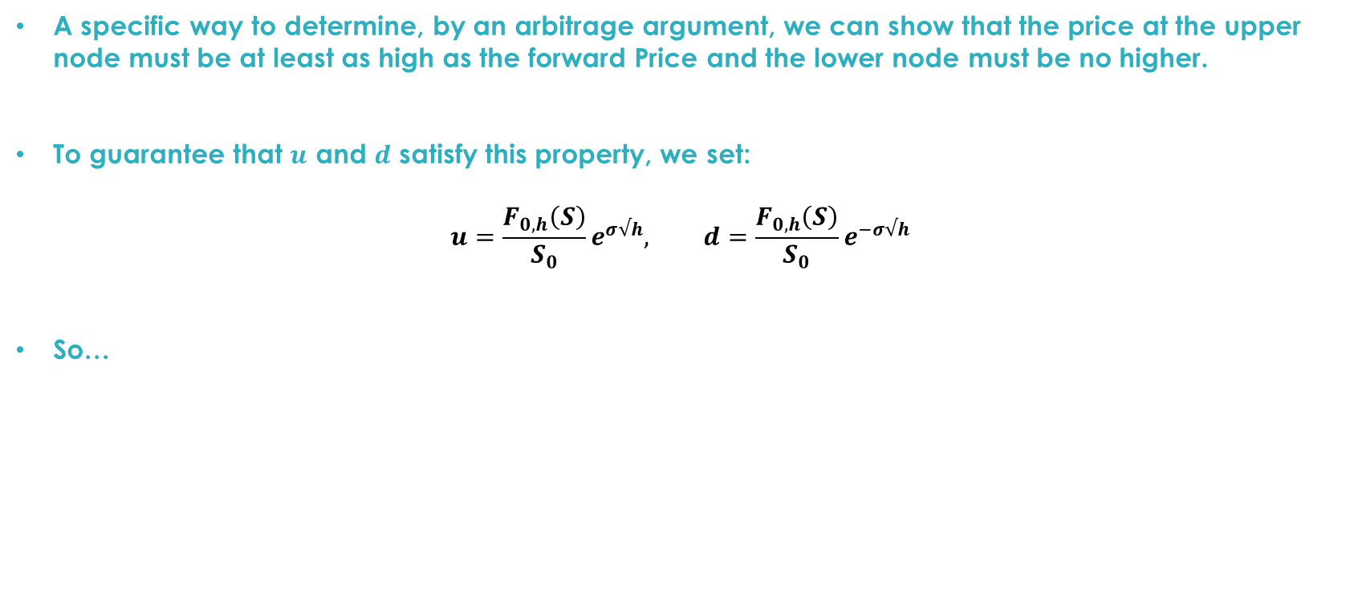
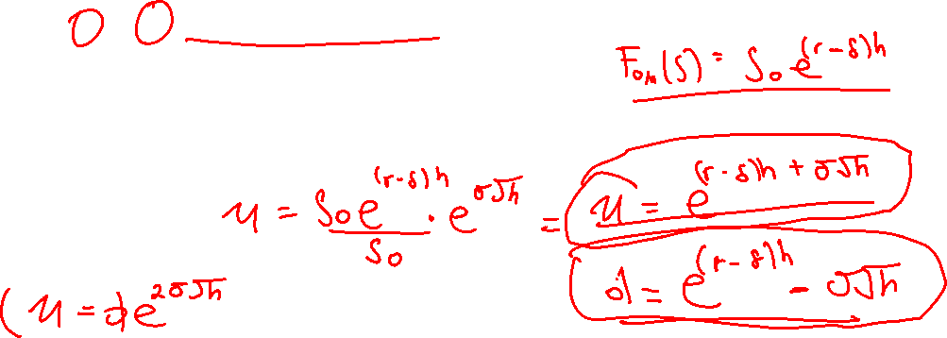
Derivatives
Volatility
A specific way to determine, by an arbitrage argument, we can show that the price at the upper node must be at least as high as the forward Price and the lower node must be no higher.
To guarantee that $u$ and $d$ satisfy this property, we set:
$$u=\frac{F_{0,h}\left(S\right)}{S_{0}}e^{σ√h}, d=\frac{F_{0,h}\left(S\right)}{S_{0}}e^{−σ√h}$$
So…

Slide 10
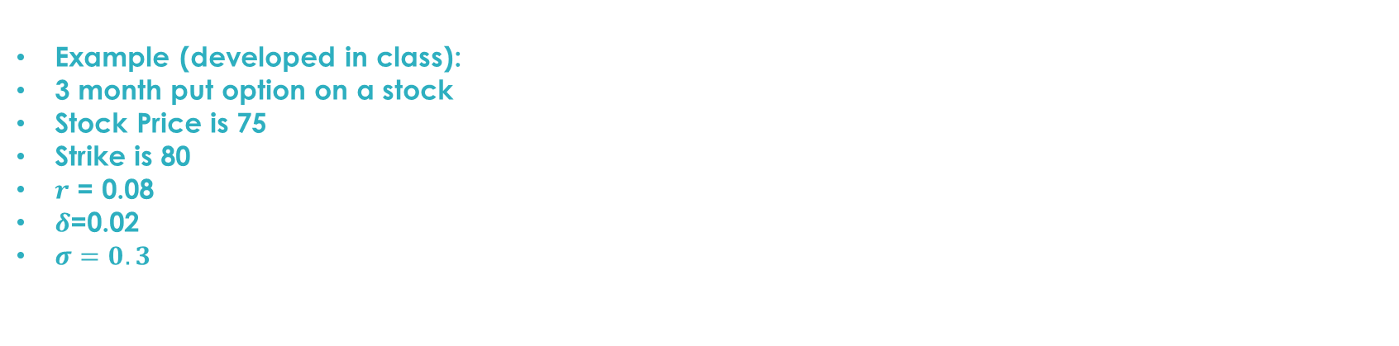
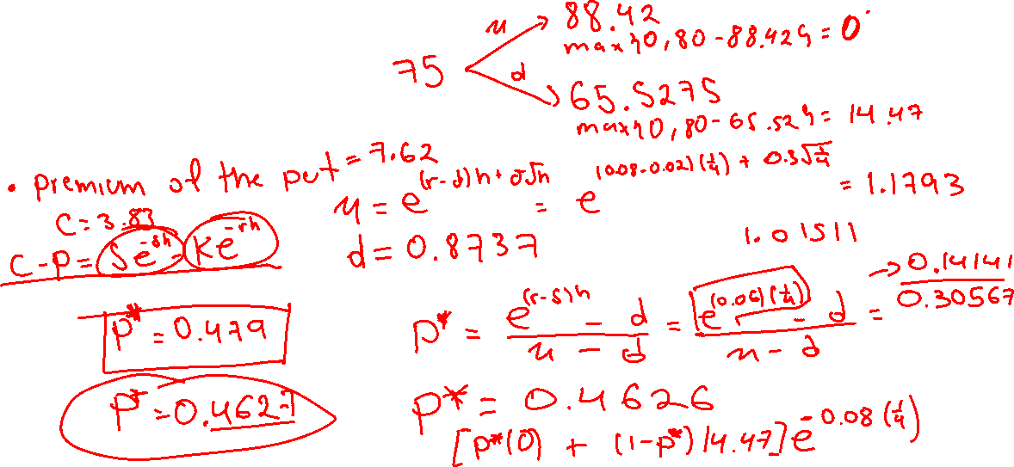
Derivatives
Binomial Trees with forward prices
Example (developed in class):
3 month put option on a stock
Stock Price is 75
Strike is 80
$r$ = 0.08
$δ$=0.02
$σ=0.3$

Slide 11
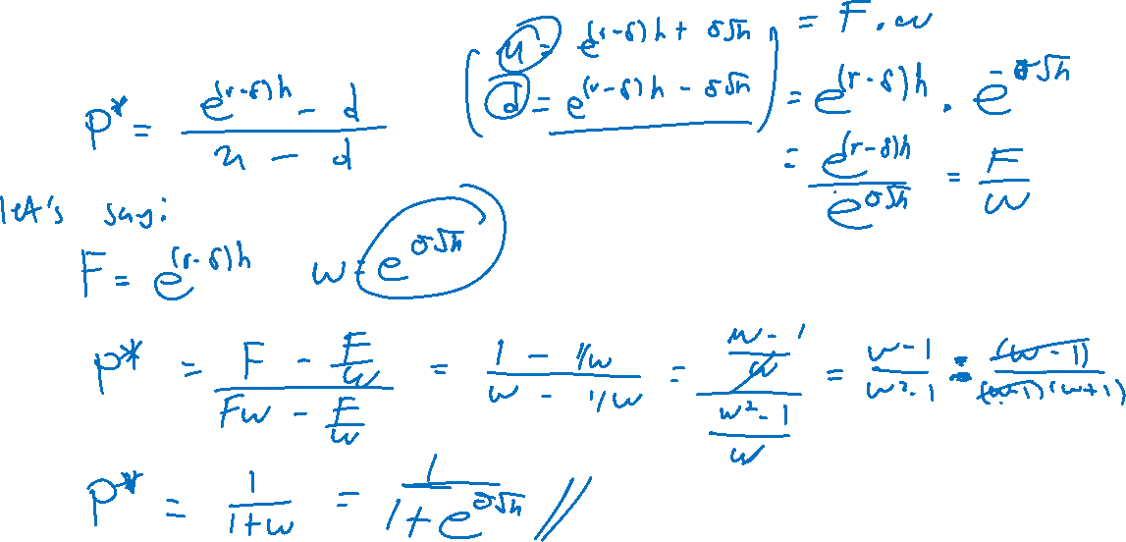
Derivatives
Binomial Trees with forward prices
Shortcuts…

Slide 12
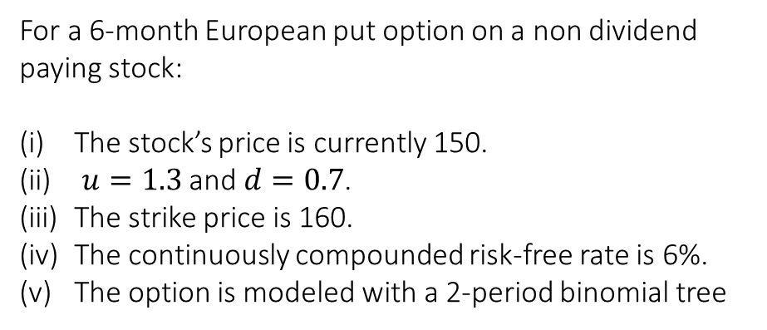
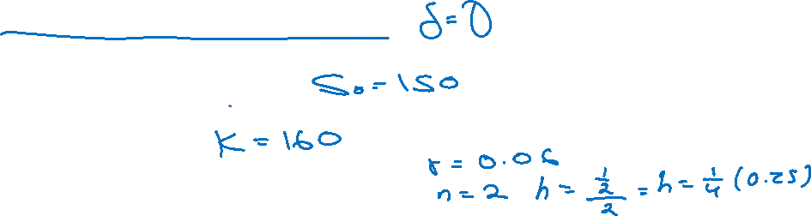
Derivatives
American Options
American options are easily accommodated. We assume that exercise is only possible at the end of a period of the tree. The only difference between a tree for an American and a European option is that when pulling back for an American option, the value of the option is the higher of the pulled back value and the exercise value. If the exercise value is higher, then it is optimal to exercise…
For a 6-month European put option on a non dividend paying stock:
The stock’s price is currently 150.
$u=1.3$ and $d=0.7$.
The strike price is 160.
The continuously compounded risk-free rate is 6%.
The option is modeled with a 2-period binomial tree

Slide 13
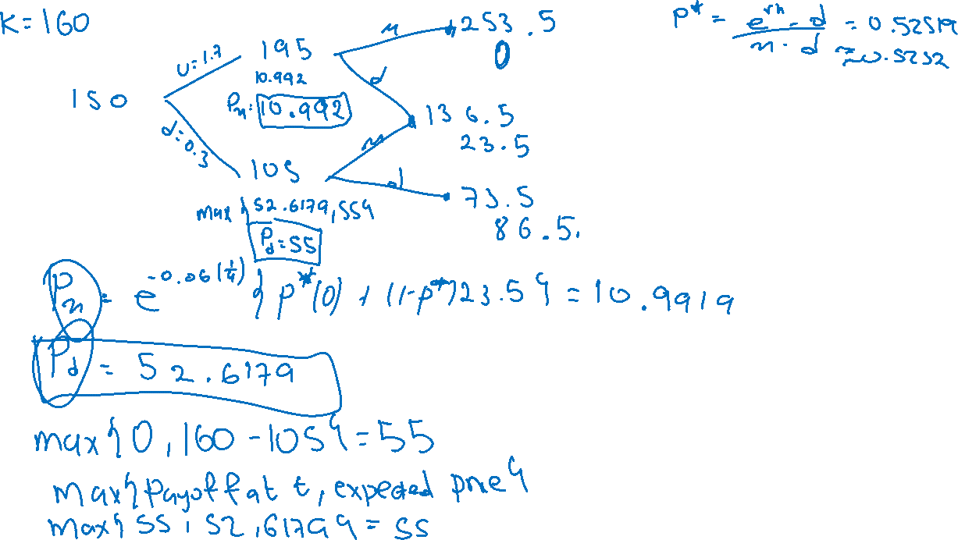

Slide 14
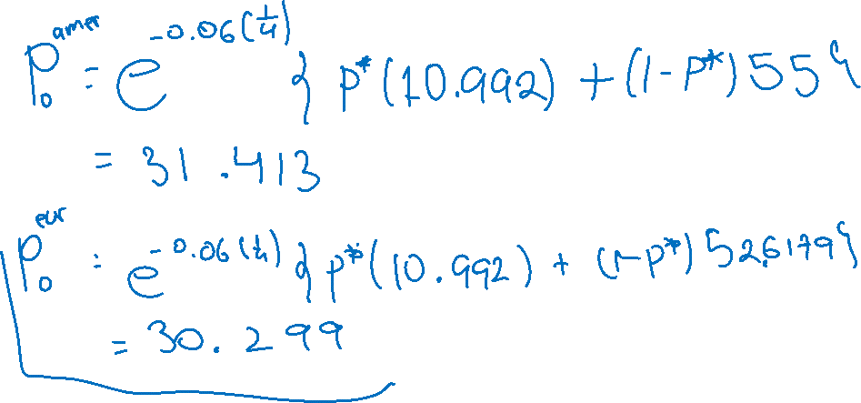
Derivatives
American Options
Example (developed in class):

